Slide 1

Java
Server
Faces
Department of Computer Engineering
Unit: 8 - JSF
Subject name & code: Advanced Java Programming (01CE0502)
Prof. Jatin Ambasana

Slide 2
INDEX
Introduction To JSF
Jsf Architecture
Jsf Life Cycle
Jsf Standard Component
Jsf Expression Language
Jsf Facelets Tags
JSF - Validation Tags
Database Access

Slide 3
INTRODUCTION TO JSF
Java server pages is a web application framework used to develop the web application with rich user interface.
The framework is based on MVC – Model View Controller architecture.
It simplifies the construction of user interface (UI) component. These UI can interact with DB to store data.
In JSF, the UI component can be created by the use of Application programming Interface(API).

Slide 4
JSF ARCHITECTURE
JSF technology is a framework for developing, building server-side User Interface Components and using them in a web application.
JSF technology is based on the Model View Controller (MVC) architecture for separating logic from presentation
What is MVC Design Pattern?
Model : Carries Data and login
View : Shows User Interface
Controller : Handles processing of an application.

Slide 5
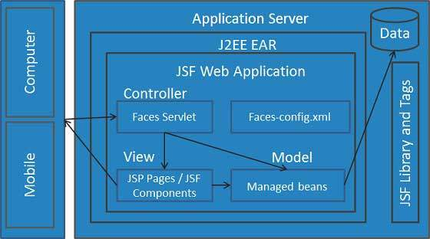
JSF ARCHITECTURE CONTINUED…
User submit the request to the application server using web browser. This request is received by JSF Faces Servlet. This servlet is a part of JSF Web Application and it need not be written. It basically acts as controller. It routes the request to appropriate page. It can read config.xml file.
The managed beans contains the form data which can access the backend or Db to retrieve desired data for processing the request. The managed bean acts as a Model.

Slide 6
JSF ARCHITECTURE CONTINUED…
The Face Servlet will determine and route the request to appropriate page for display information. Typically these web pages are in the xhtml file. This part acts as view.
Finally the web page is rendered and sent back to the web browser.

Slide 7
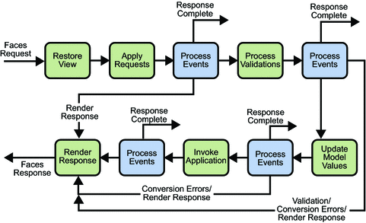
JSF LIFE CYCLE:

Slide 8
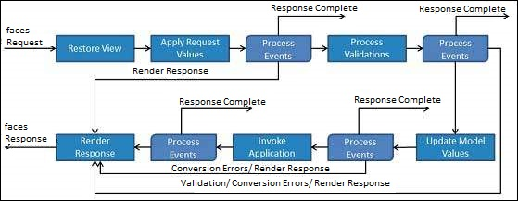
JSF LIFE CYCLE:
Restore View: This is the first phase in JSF Request processes life cycle. This phase is used for constructing view to display the front end. This view is stored in FacesContext instance and using this information request can be processed.
Apply request Values: After the component tree is created, each component in the component tree extracts its new value from the request parameters. Component stores this value. If the conversion fails, an error message is generated and queued on FacesContext. This message will be displayed during the render response phase, along with any validation errors.

Slide 9
JSF LIFE CYCLE CONTINUED…
Process validation : During this phase, JSF processes all validators registered on the component tree.
Update model values: After the JSF checks that the data is valid, it walks over the component tree and sets the corresponding server-side object properties to the components local values.

Slide 10
JSF LIFE CYCLE CONTINUED…
Invoke application: During this phase, JSF handles any application-level events, such as submitting a form/linking to another page.
Render response: During this phase, JSF asks container / application server to render the page if the application is using JSP pages. After the content is rendered.

Slide 11
JSF STANDARD COMPONENT:
JSF <h:inputText>Tag
JSF <h:outputText> Tag
JSF <h:form> Tag
JSF <h:commandButton> Tag

Slide 12
1 JSF <h:inputText>Tag
The JSF <h: inputText> tag is used to render an input field on the web page.
It is used within a <h: form> tag to declare input field that allows user to input data.
<h:inputText id="sid-id" value="#{student.id}"/>
Attribute name | Description
Id | It is an identifier for this component. This id must be unique. You can use it to access HTML element in CSS and JS file.
Value | It is used to collect present value of the inputText.
maxlength | The maximum number of characters that may be entered in this field.
size | The number of characters used to determine the width of this field .

Slide 13
2 JSF - <h:selectOneMenu>
The h:selectOneMenu tag renders an HTML input element of the type "select" with size not specified.
<h:selectOneMenu value = "#{student.city}">
<f:selectItem itemValue = "1" itemLabel = "UNJHA" />
<f:selectItem itemValue = "2" itemLabel = "MEHSANA" />
<f:selectItem itemValue = "3" itemLabel = "KADI" />
<f:selectItem itemValue = "4" itemLabel = "VISHNAGAR" />
</h:selectOneMenu>

Slide 14
3 JSF <h:outputText> Tag
It is used to render a plain text.
<h:outputText value="hello"></h:outputText>
Attribute | Description
Value | It holds current value of this component.
Id | It is an identifier for this component. This id must be unique. You can use it to access HTML element in CSS and JS file.
style | It is used to apply CSS for the component.
class | It gives class name to the component. It is used to access component from CSS and JS file.
lang | It is used to specify language. It helps to make web page localized.

Slide 15
4 JSF <h:form> Tag
The <h:form> tag represents an input form.
It includes child components that can contain data which is either presented to the user or submitted with the form.
It can also include HTML markup to lay out the components on the page.
<h:form>
<!-- form elements -->
</h:form>

Slide 16
5 JSF <h:commandButton> Tag
It creates a submit button and used to submit a application form.
You can create it by using the following syntax.
<h:commandButton value="Submit“ action="response.xhtml"> </h:commandButton>

Slide 17
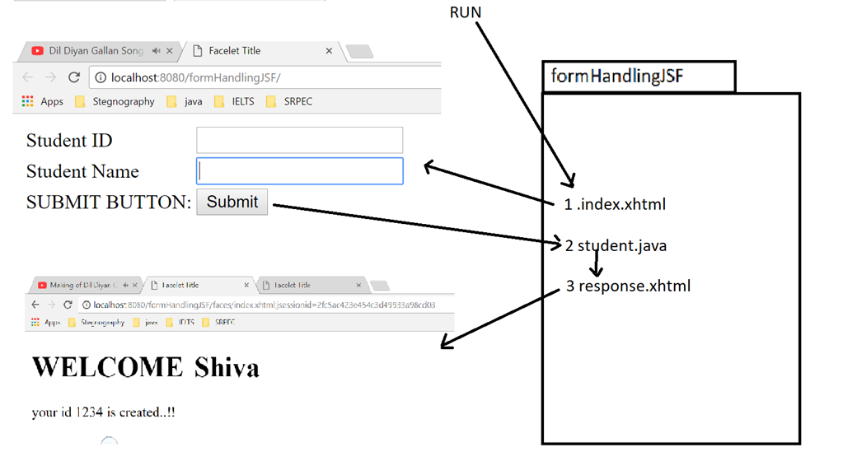
PROG 0 : JSF FORM HANDLING EXAMPLE:

Slide 18
PROG 0: FILES NEED TO BE CREATED
Total 3 file need to be created
index.xhtml
Student.java
response.xhtml

Slide 19
1. Index.xhtml
<?xml version='1.0' encoding='UTF-8' ?>
<!DOCTYPE html>
<html xmlns="http://www.w3.org/1999/xhtml"
xmlns:h="http://xmlns.jcp.org/jsf/html">
<h:head>
<title>Facelet Title</title>
</h:head>
<h:body>
<h:form>
<table>
<tr>
<td>Student ID</td>
<td><h:inputText id="sid-id" value="#{student.id}"/></td>
</tr>

Slide 20
1. Index.xhtml
<tr>
<td>Student Name</td>
<td><h:inputText id="sname-id" value="#{student.name}"/></td>
</tr>
<tr>
<td>SUBMIT BUTTON:</td>
<td><h:commandButton value="Submit" action="response.xhtml"></h:commandButton></td>
</tr>
</table>
</h:form>
</h:body>
</html>

Slide 21
2. student.java JSF MANAGED BEAN: JAVA CLASS
import javax.annotation.ManagedBean;
import javax.enterprise.context.ApplicationScoped;
import javax.inject.Named;
@Named("student")
@ManagedBean
@ApplicationScoped
public class student {
int id;
String name;
public int getId() {
return id;
}
public void setId(int id)
{
this.id = id;
}
public String getName() {
return name;
}
public void setName(String name) {
this.name = name;
}
}

Slide 22
3 response.xhtml
<?xml version='1.0' encoding='UTF-8' ?>
<!DOCTYPE html >
<html xmlns="http://www.w3.org/1999/xhtml"
xmlns:h="http://xmlns.jcp.org/jsf/html">
<h:head>
<title>Facelet Title</title>
</h:head>
<h:body>
<h1> WELCOME <h:outputText value="#{student.name}"> </h:outputText></h1>
your id <h:outputText value="#{student.id}"> </h:outputText> is created..!!
</h:body>
</html>

Slide 23
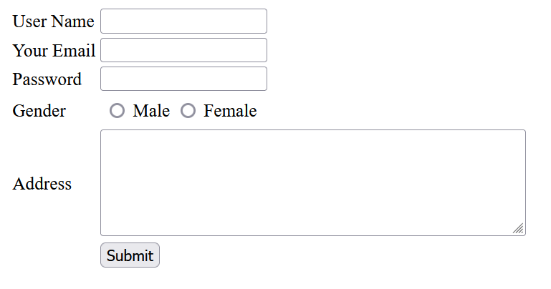
PROG 1: JSF COMPONENTS

Slide 24
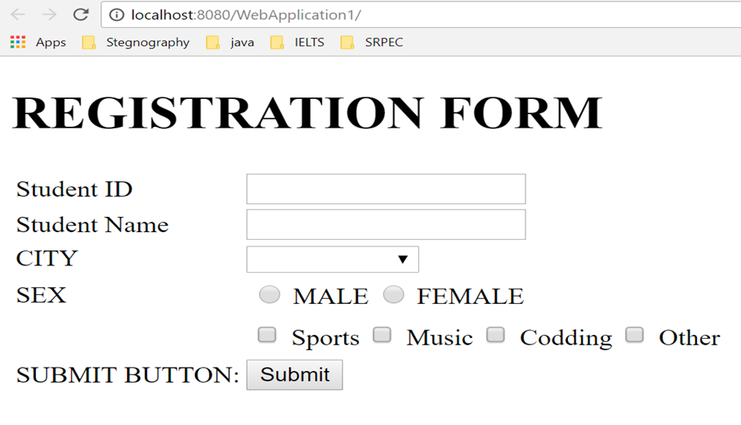
PROG 1: JSF COMPONENTS

Slide 25
<?xml version='1.0' encoding='UTF-8' ?>
<!DOCTYPE html>
<html xmlns="http://www.w3.org/1999/xhtml"
xmlns:h="http://xmlns.jcp.org/jsf/html"
xmlns:f="http://xmlns.jcp.org/jsf/core">
<h:head>
<title>Facelet Title</title>
</h:head>
<h:body>
<h1>REGISTRATION FORM</h1>
<h:form>
<table>
<tr>
<td>Student ID</td>
<td><h:inputText id="sid-id" value="#{student.id}"/></td>
</tr>
<tr>
<td>Student Name</td>
<td><h:inputText id="sname-id" value="#{student.name}"/></td>
</tr>
<tr>
<td>CITY</td>
<td>
<h:selectOneMenu value = "#{student.city}">
<f:selectItem itemValue = "1" itemLabel = "Rajkot" />
<f:selectItem itemValue = "2" itemLabel = "Ahemdabad" />
<f:selectItem itemValue = "3" itemLabel = "Baroda" />
<f:selectItem itemValue = "4" itemLabel = "Surat" />
</h:selectOneMenu>
</td>
</tr>
<tr>
<td>SEX</td>
<td>
<h:selectOneRadio value = "#{student.sex}">
<f:selectItem itemValue = "1" itemLabel = "MALE" />
<f:selectItem itemValue = "2" itemLabel = "FEMALE" />
</h:selectOneRadio>
</td>
</tr>
<tr>
<td>Hobby:</td>
<td>
<h:selectManyCheckbox value = "#{student.hobby}">
<f:selectItem itemValue = "1" itemLabel = "Sports" />
<f:selectItem itemValue = "2" itemLabel = "Music" />
<f:selectItem itemValue = "3" itemLabel = "Codding" />
<f:selectItem itemValue = "4" itemLabel = "Other" />
</h:selectManyCheckbox>
</td>
</tr>
<tr>
<td>SUBMIT BUTTON:</td>
<td><h:commandButton value="Submit" action="response.xhtml"></h:commandButton></td>
</tr>
</table>
</h:form>
</h:body>
</html>

Slide 26
JSF EXPRESSION LANGUAGE:
JSF expression language allows the user to access the data dynamically form the java Bean component.
JSF provides rich expression language.
We can provide normal operation using #{operation-expression} notation
These expression can be of two types
Property expression:
#{<beanName>.<property>}
Method expression:
#{<beanName>.<method>}

Slide 27
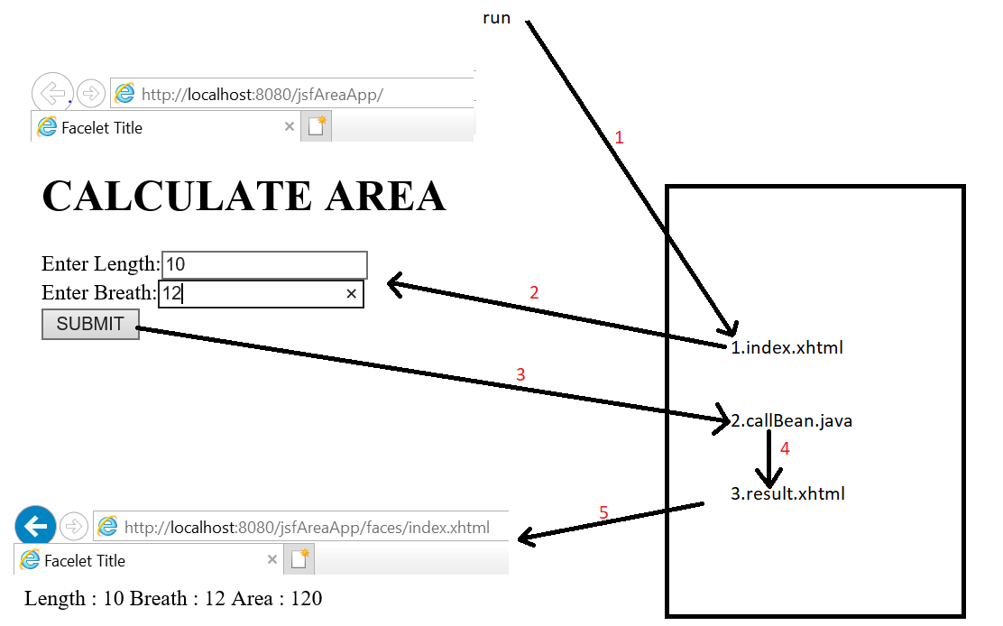
PROG 5:Create a JSF application that will calculate the area of rectangle. Make use of expression language.

Slide 28
Index.xhtml
<?xml version='1.0' encoding='UTF-8' ?>
<!DOCTYPE html>
<html xmlns="http://www.w3.org/1999/xhtml"
xmlns:h="http://xmlns.jcp.org/jsf/html">
<h:head>
<title>Facelet Title</title>
</h:head>
<h:body>
<h1>CALCULATE AREA</h1>
<h:form>
Enter Length:<h:inputText value="#{calBean.len}"/><br/>
Enter Breath:<h:inputText value="#{calBean.br}"/><br/>
<h:commandButton value="SUBMIT" action="result.xhtml"/>
</h:form>
</h:body>
</html>

Slide 29
calBean.java
import javax.annotation.ManagedBean;
import javax.enterprise.context.ApplicationScoped;
import javax.inject.Named;
@Named(value = "calBean")
@ManagedBean
@ApplicationScoped
public class calBean {
int len,br;
public calBean() {
}
public int getLen() {
return len;
}
public void setLen(int len) {
this.len = len;
}
public int getBr() {
return br;
}
public void setBr(int br) {
this.br = br;
}
public int area(){
int area = len*br;
return area;
}
}

Slide 30
Result.xhtml
<?xml version='1.0' encoding='UTF-8' ?>
<!DOCTYPE html>
<html xmlns="http://www.w3.org/1999/xhtml"
xmlns:h="http://xmlns.jcp.org/jsf/html">
<h:head>
<title>Facelet Title</title>
</h:head>
<h:body>
Length : #{calBean.len}
Breath : #{calBean.br}
Area : #{calBean.area()}
</h:body>
</html>

Slide 31
JSF FACELETS TAGS:
JSF provides special tags to create common layout for a web application called facelets tags. These tags provide flexibility to manage common parts of multiple pages at one place.
For these tags, you need to use the following namespaces of URI in html node
<html xmlns = "http://www.w3.org/1999/xhtml"
xmlns:ui = "http://java.sun.com/jsf/facelets" >

Slide 32
FOUR FACELET TAGS USED TO CREATE THE TEMPLATE:
S.No | Tag & Description
1 | ui:insert Used in template file. It defines contents to be placed in a template. ui:define tag can replaced its contents.
2 | ui:define Defines the contents to be inserted in a template.
3 | ui:include Includes contents of one xhtml page into another xhtml page.
4 | ui:composition Loads a template using template attribute. It can also define a group of components to be inserted in xhtml page.

Slide 33
JSF - Validation Tags
JSF provides inbuilt validators to validate its UI components. These tags can validate the length of the field, the type of input which can be a custom object.
S.No | Tag & Description
1 | f:validateLength: Validates the length of a string
2 | f:validateLongRange: Validates the range of a numeric value
3 | f:validateDoubleRange: Validates the range of a float value

Slide 34
JSF - f:validateLength
f:validateLength tag is used to validate the length of a string value in a particular range.
JSF Tag
<f:validateLength minimum = "5" maximum = "8" />
Tag Attributes
S.No | Attribute & Description
1 | minimum A String with a minimum number of characters
2 | maximum A String with a maximum number of characters

Slide 35
JSF - f:validateLongRange
f:validateLongRange tag is used to validate the long value in a particular range.
JSF Tag
Tag Attributes
<f:validateLongRange minimum = "5" maximum = "200" />
S.No | Attribute & Description
1 | minimum Minimum long value within an optional range
2 | maximum Maximum long value within an optional range

Slide 36
JSF - f:validateDoubleRange
f:validateDoubleRange tag is used to validate a value to a range of float values.
JSF Tag
Tag Attributes
<f:validateDoubleRange minimum = "1000.50" maximum = "10000.50" />
S.No | Attribute & Description
1 | minimum Minimum long value within an optional range
2 | maximum Maximum long value within an optional range

Slide 37
Program 6: DATABASE ACCESS
Index.xhtml
<?xml version='1.0' encoding='UTF-8' ?>
<!DOCTYPE html>
<html xmlns="http://www.w3.org/1999/xhtml"
xmlns:h="http://xmlns.jcp.org/jsf/html">
<h:head>
<title>Facelet Title</title>
</h:head>
<h:body>
<h1>JDBC JSF EXAMPLE</h1>
<h:form>
USER NAME: <h:inputText id="uname“ value = "#{user.uname}"/>
EMAIL: <h:inputText id="email“ value = "#{user.email}"/>
<h:commandButton action = "#{user.submit()}" value = "SUBMIT"/>
</h:form>
</h:body>
</html>

Slide 38
Program 6: DATABASE ACCESS
response.xhtml
<?xml version='1.0' encoding='UTF-8' ?>
<!DOCTYPE html>
<html xmlns="http://www.w3.org/1999/xhtml"
xmlns:h="http://xmlns.jcp.org/jsf/html">
<h:head>
<title>Facelet Title</title>
</h:head>
<h:body>
Hello <h:outputText value="#{user.uname}"/>
Your Record has been Saved Successfully!
</h:body>
</html>

Slide 39
Program 6: DATABASE ACCESS
User.java
import java.sql.*;
import javax.inject.Named;
import javax.annotation.ManagedBean;
import javax.enterprise.context.ApplicationScoped;
@Named(value = "user")
@ManagedBean
@ApplicationScoped
public class User {
String uname,email;
public User() {
}
public String getUname() {
return uname;
}
public void setUname(String uname) {
this.uname = uname;
}
public String getEmail() {
return email;
}
public void setEmail(String email) {
this.email = email;
}

Slide 40
Program 6: DATABASE ACCESS
User.java
public boolean save(){
int result = 0;
try{
Class.forName("com.mysql.jdbc.Driver");
Connection con = DriverManager.getConnection( "jdbc:mysql://localhost:3306/Emp","root","");
PreparedStatement stmt = con.prepareStatement("insert into user(name,email) values(?,?)");
stmt.setString(1, this.getUname());
stmt.setString(2, this.getEmail());
result = stmt.executeUpdate();
}catch(Exception e){
System.out.println(e);
}
if(result == 1){
return true;
}else
return false;
}
public String submit(){
if(this.save()){
return "response.xhtml";
}else{
return "index.xhtml";
}
}
}

